Slide 1
Felix instruments – Applied Food Science sales training
Galen George & Eric munoz-Garcia | Application Scientists
Suzy Truitt | Distributor Manager | struitt@felixinstruments.com
Version 2.0 Updated October 2019

Slide 2
Overview
Introduction to Felix Instruments
Explanation of each product
Why it’s important
How it works
Use cases and Applications
Advantages
Sales opportunities

Slide 3
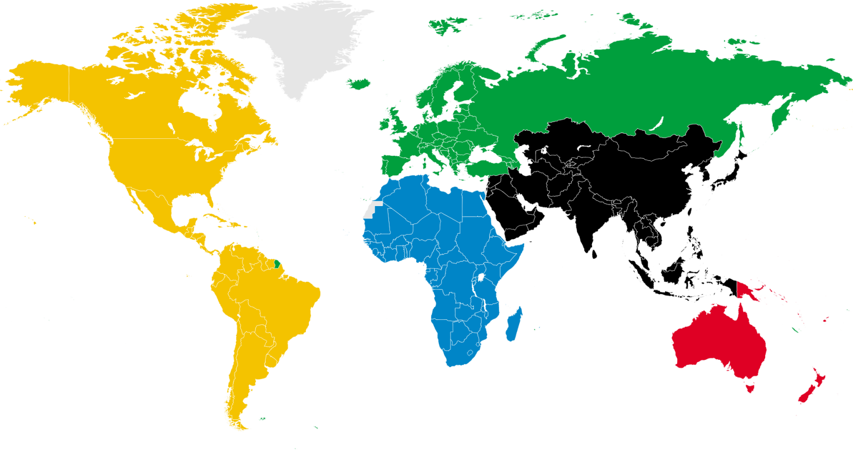
Design | Engineer | Build
All instruments built in Camas, WA USA

Slide 4
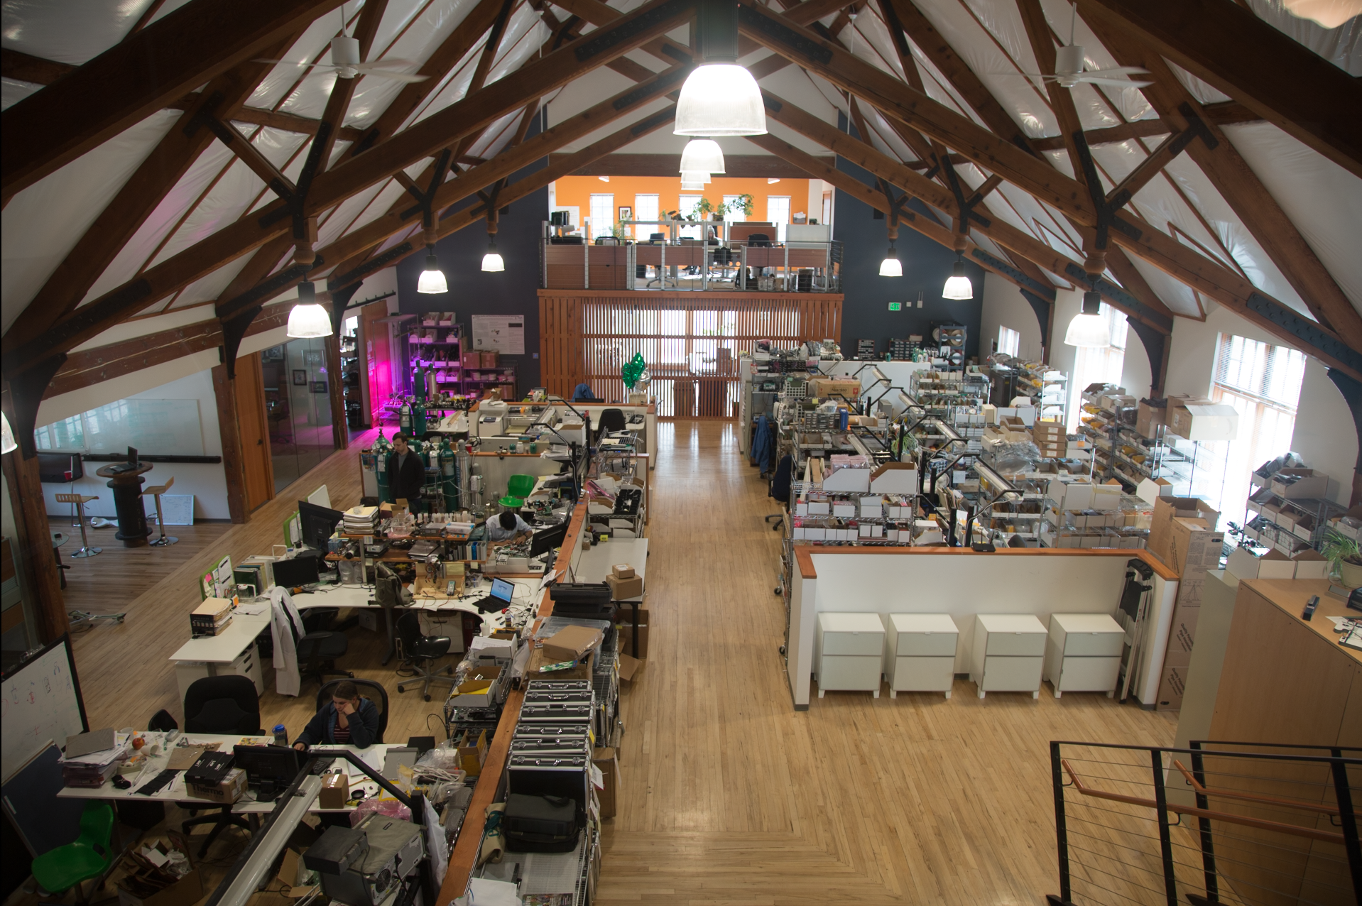
About Felix Instruments – Applied Food Science
Engineering, Manufacturing, and Business under one roof
Started in 2012
Subsidiary of CID Bio-Science, Inc.
Portable Instrumentation for Plant Physiology Measurement
Founded in 1989
Created to expand our market to commercial food producers

Slide 5
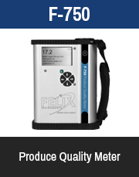
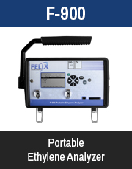
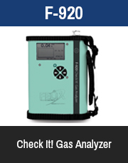
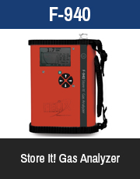
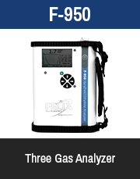
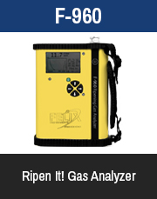
Full Felix Instruments Product Line
All Felix Instruments feature:
SD Card for internal data-logging
GPS for mapping sample locations
Bringing plant science technology from the laboratory and into the hands of the commercial produce industry.

Slide 6
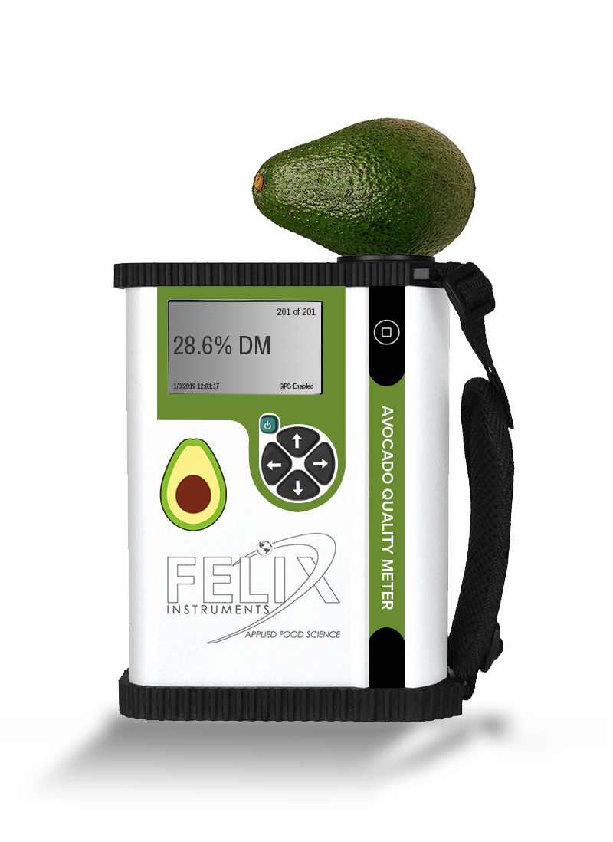
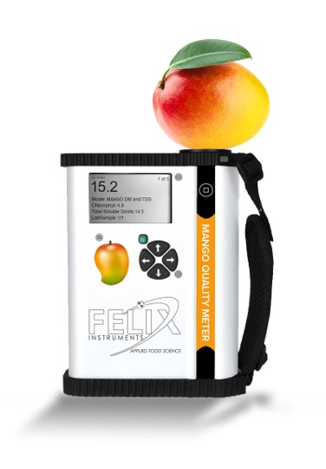
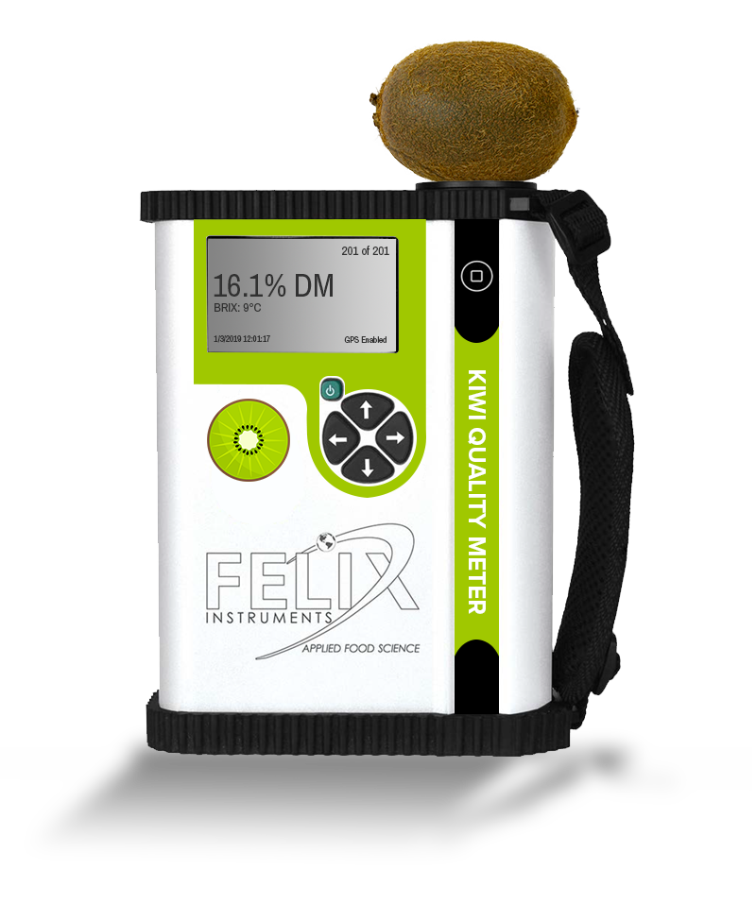
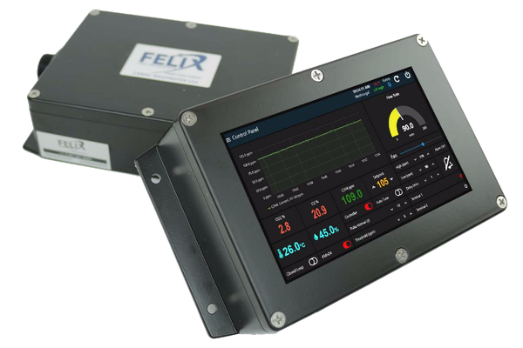
Full Felix Instruments Product Line - Continued
F-751 Avo
F-751 Mango
F-751 Kiwi
F-901R AccuRipe
F-901S AccuStore
Bringing plant science technology from the laboratory and into the hands of the commercial produce industry.

Slide 7
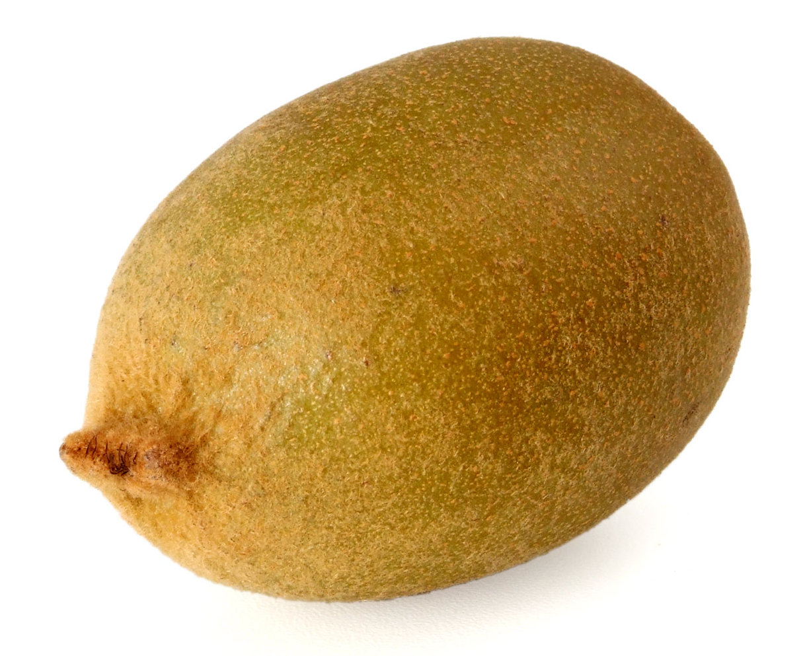
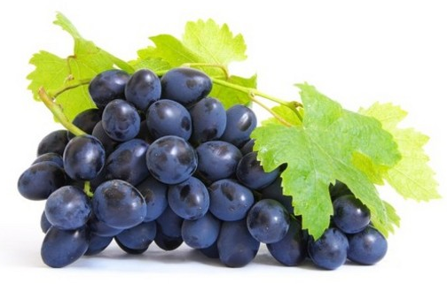
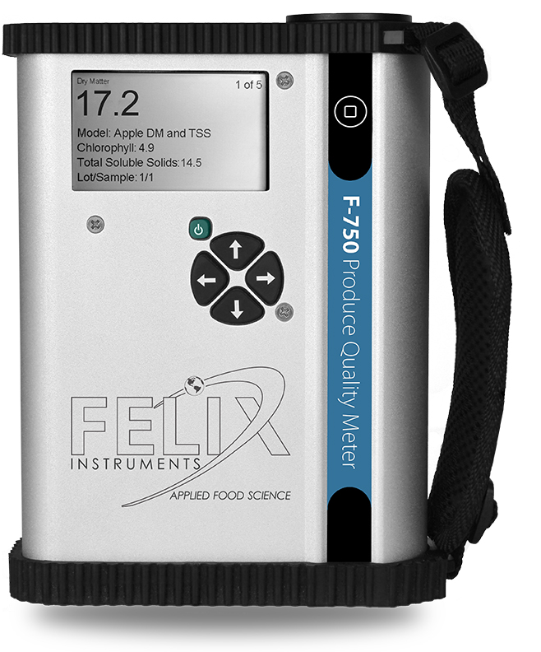
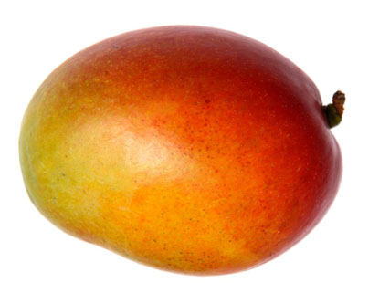
F-750 produce quality meter – WHY we need it
Fruit is complex
Sugars
Acids
Dry Matter
Molecules inside the fruit change as fruit ripens
Need a non-destructive, standardized way to measure quality!

Slide 8
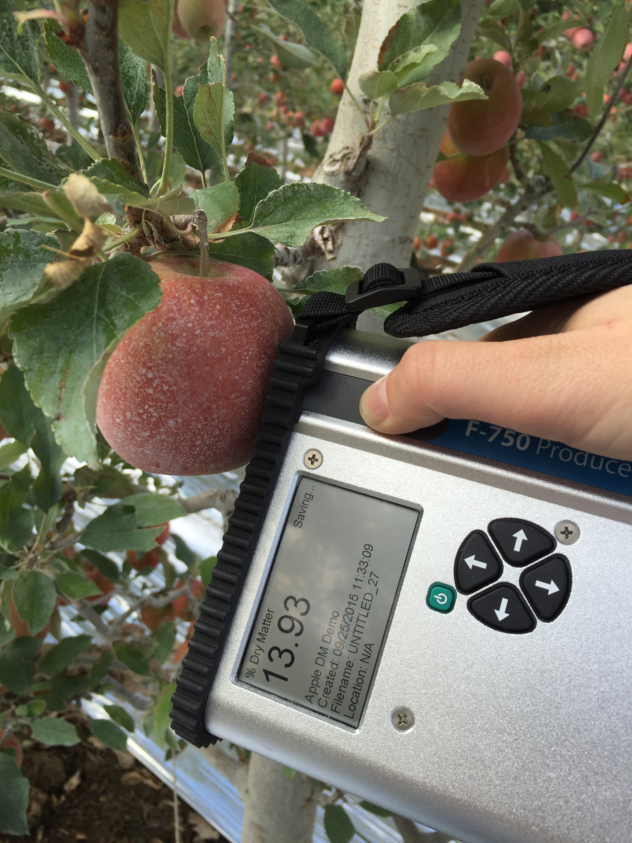
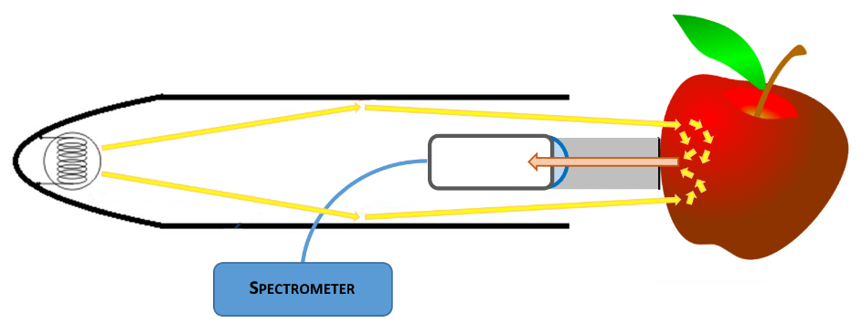
F-750 produce quality meter – How it works
Non-destructive tool for rapid quality assessment
Acts like a high-powered flashlight – light enters fruit and returns to F-750
Measures light interactance with groups of molecules
NIR and visible spectrometer 310-1100 nm
Pigments, sugars, water
Measures internal qualities of produce in under 10 seconds
Optics arranged to see tissue instead of skin

Slide 9
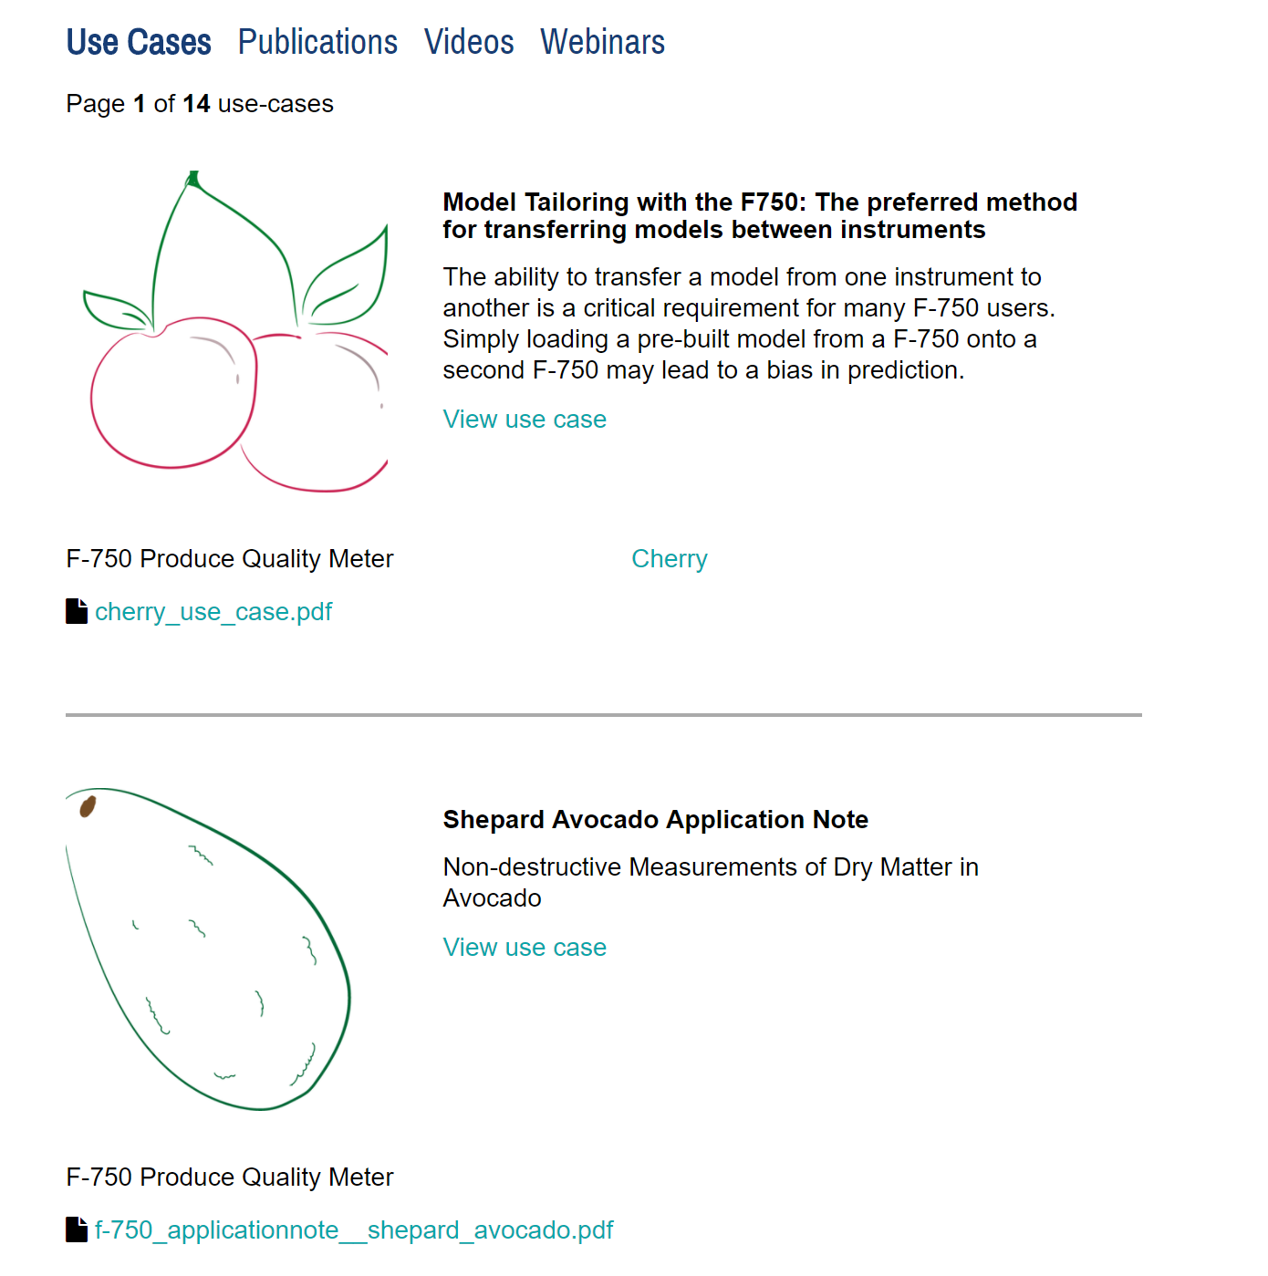
F-750 produce quality meter – Calibration
Users build their own custom model
Equipped with generic demonstration models:
Avocado
Mango
Apple
Pear
Cherry
Sultana
Kiwifruit
Persimmon

Slide 10
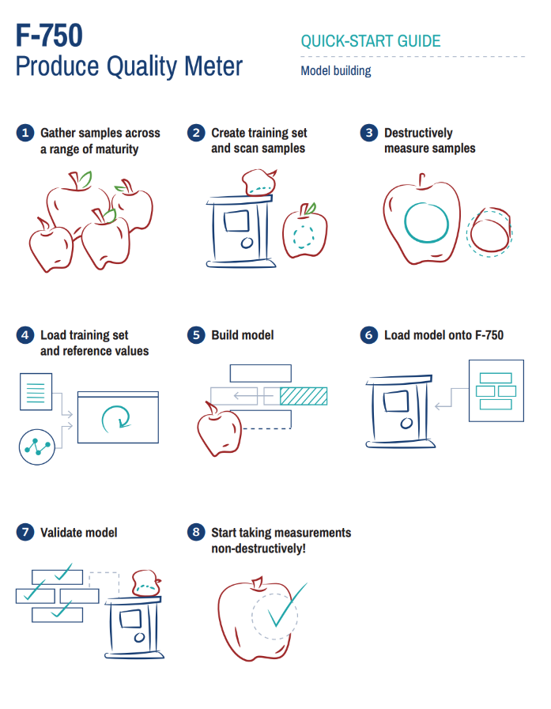
Visual step-by-step guides
Available under F-750 “Manuals” online
Quick-Start Guide for new models
Model Tailoring Guide

Slide 11
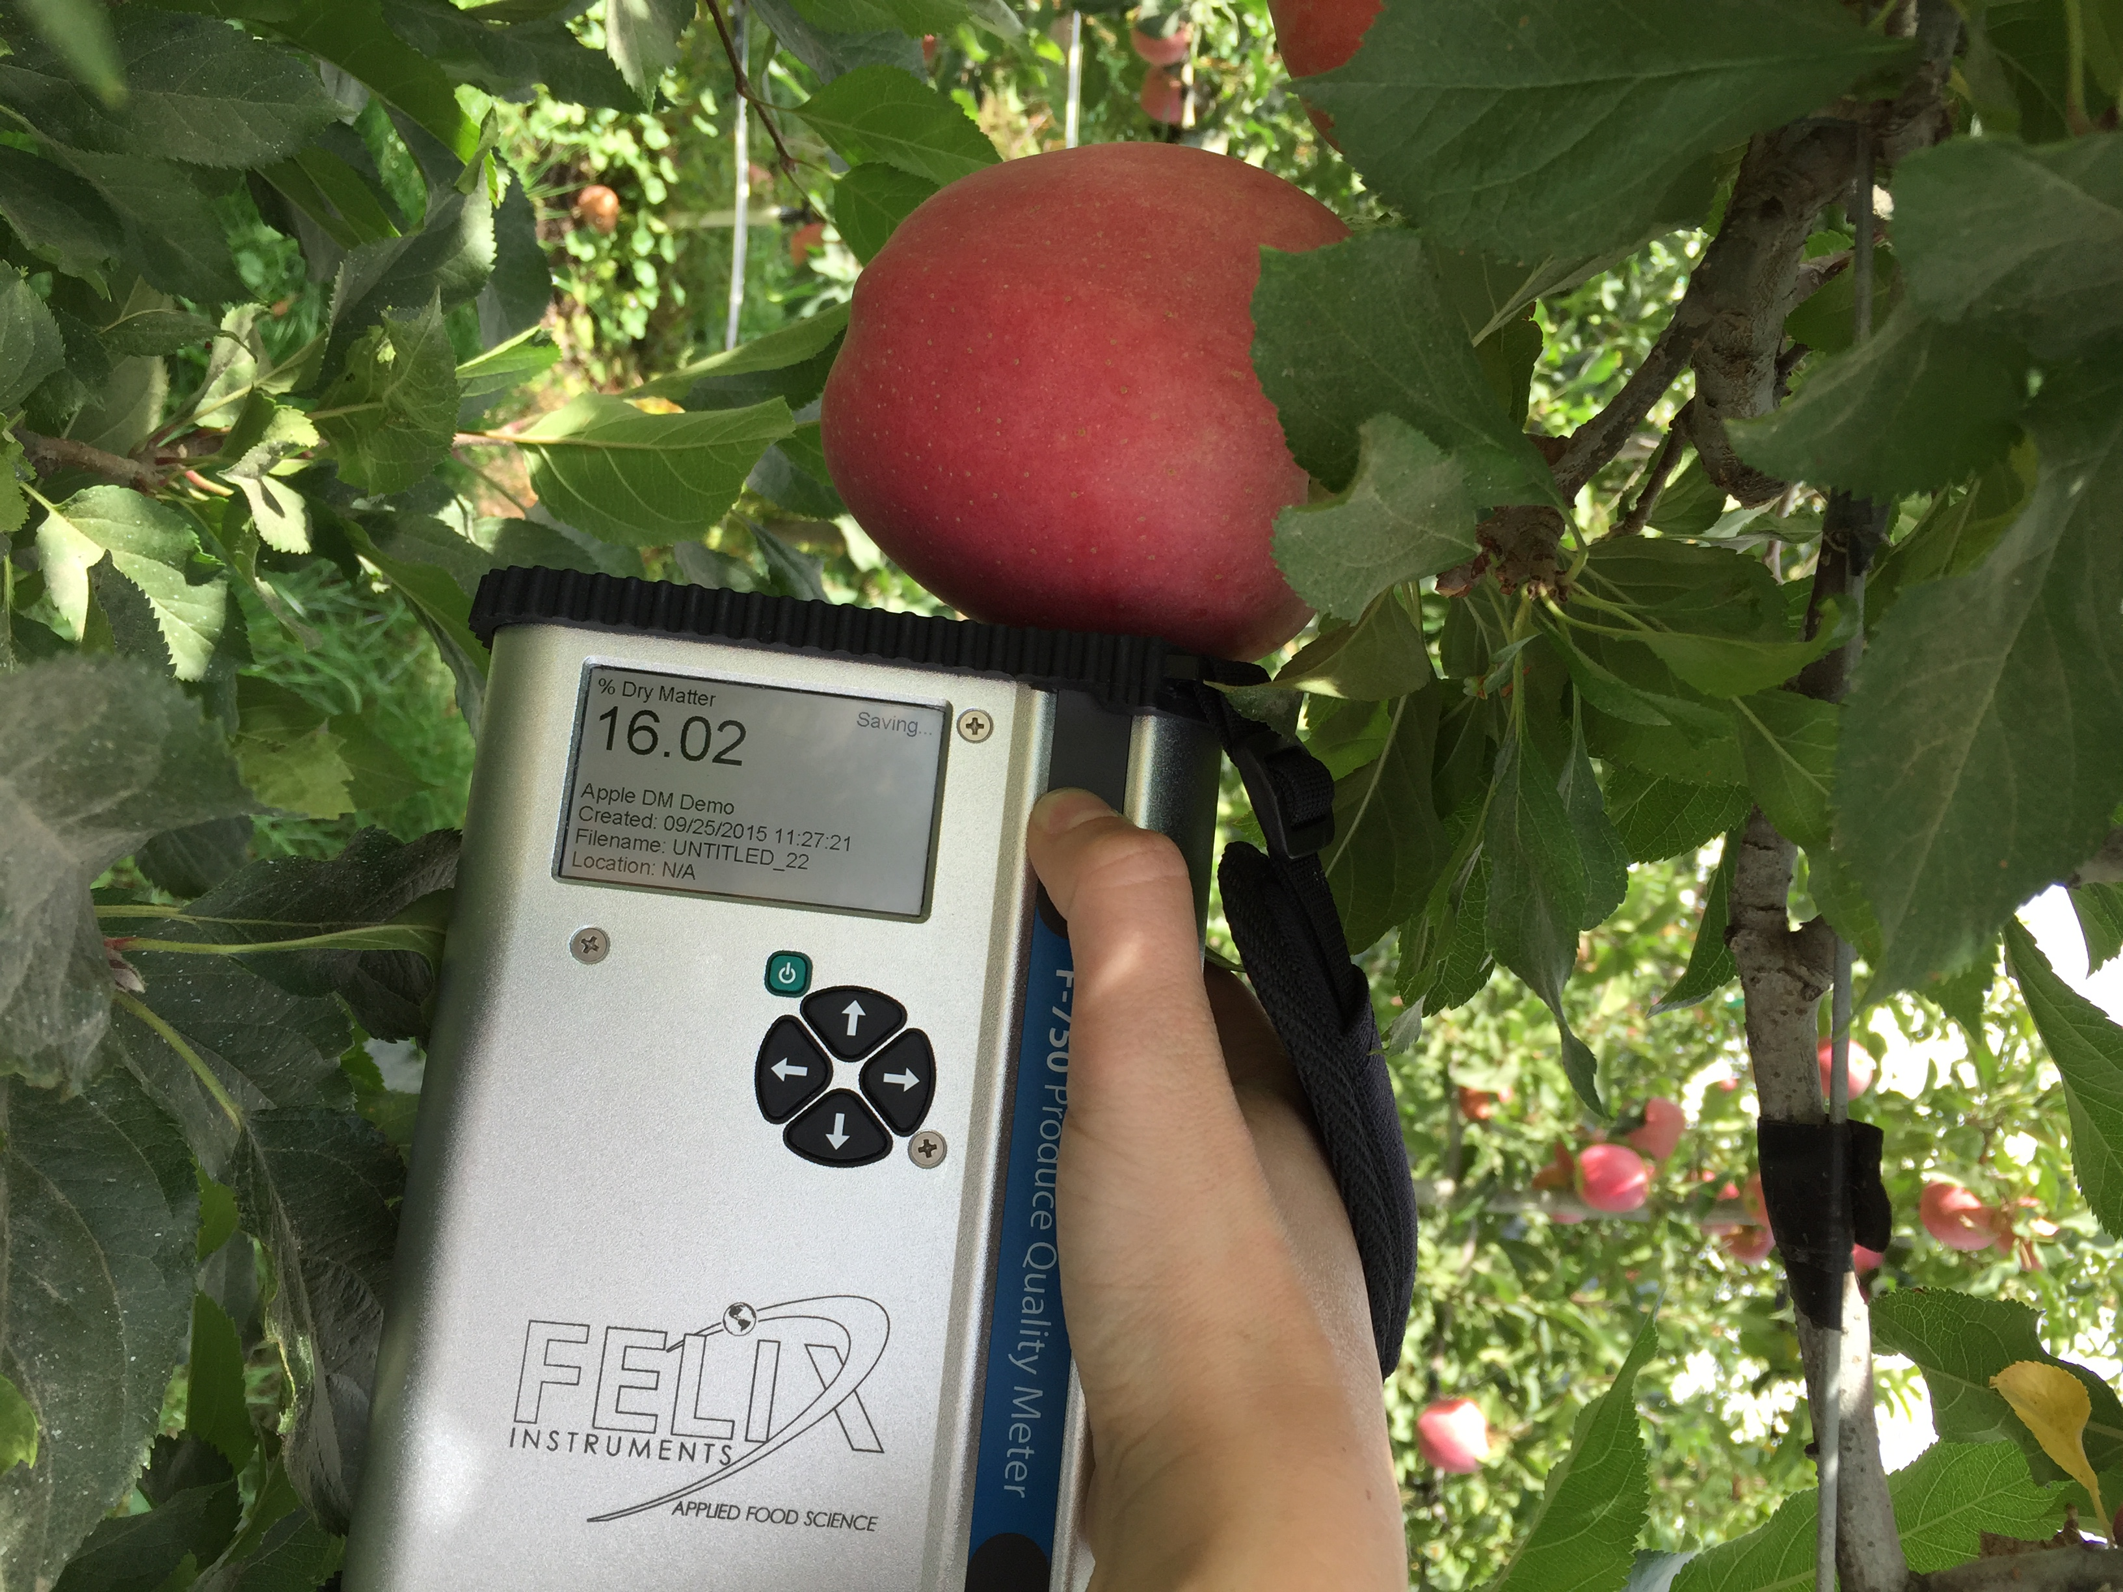
F-750 produce quality meter - Uses
Use as a crop management tool
Time harvest with periods of peak quality
Assign incoming produce to various controlled atmosphere storage
Assess quality at import locations
Assign produce to specific retail markets
Inspection tool for retail outlets

Slide 12
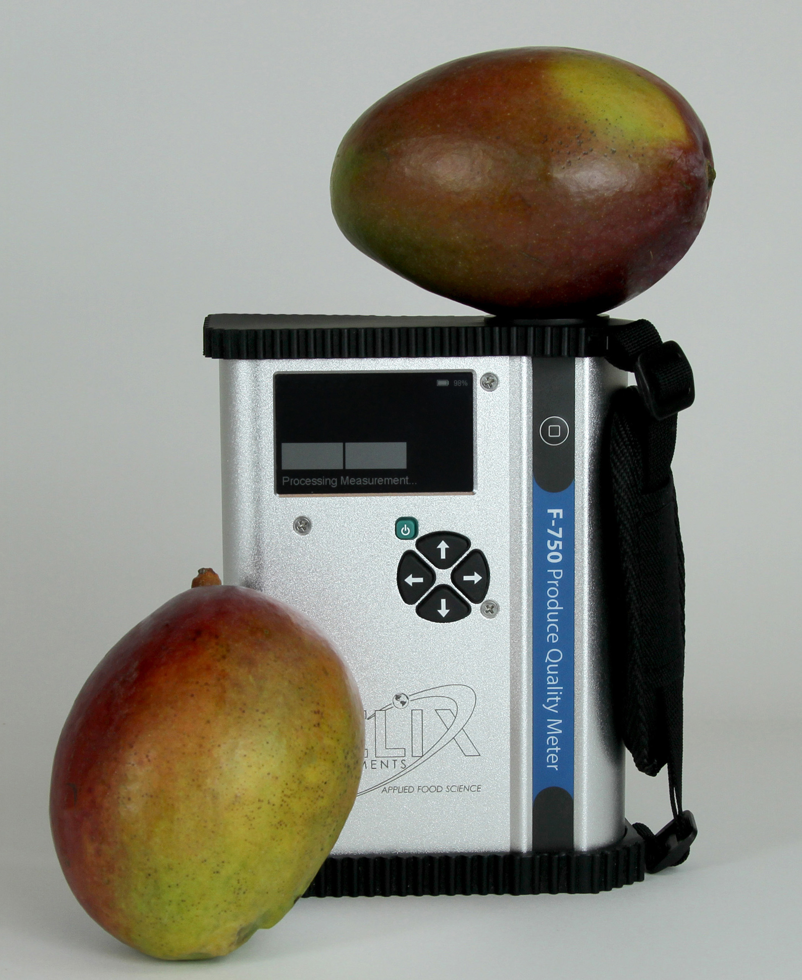
F-750 produce quality meter - Advantages
Non-destructive measurements
No technique required once models are built
Models are specific to the qualities and commodities of the user
Improved fruit quality means produce can sell for a higher cost
Consistency builds brand or commodity appreciation

Slide 13
F-750 Competitors
 | F-750 | NIRvana
Wavelength | 303- 1070 nm | 350-1100 nm
Resolution | 8-13 nm | 8-13 nm
Battery life | 16,000 samples | Full day of operation
New instruments coming on the market, but all released do not have the functionality, flexibility, and field application of the F-750

Slide 14
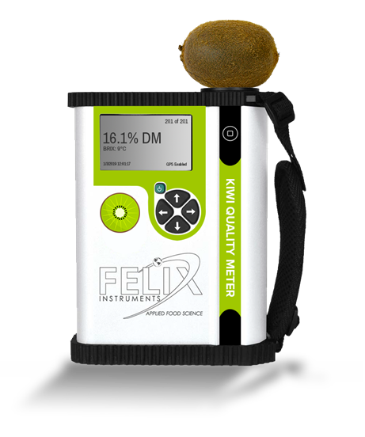
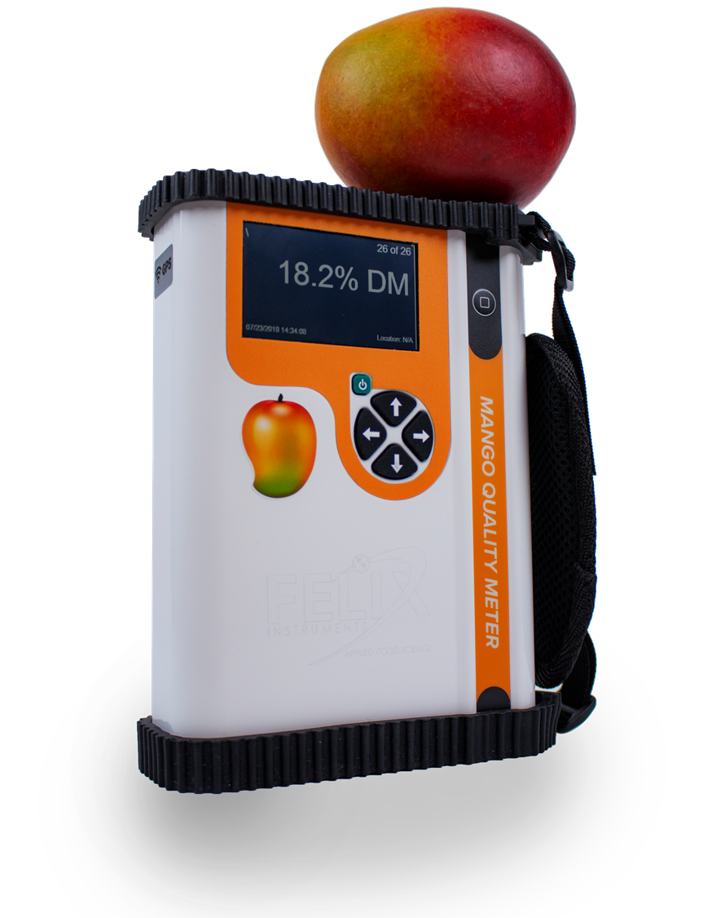
F-751 commodity-specific Produce quality meters
Two commodity-specific meters currently being sold:
F-751 Avocado Quality Meter
F-751 Mango Quality Meter
F-751 Kiwi Quality Meter
To be released by end of 2019
KEY ADVANTAGE:
More user-friendly than F-750

Slide 15
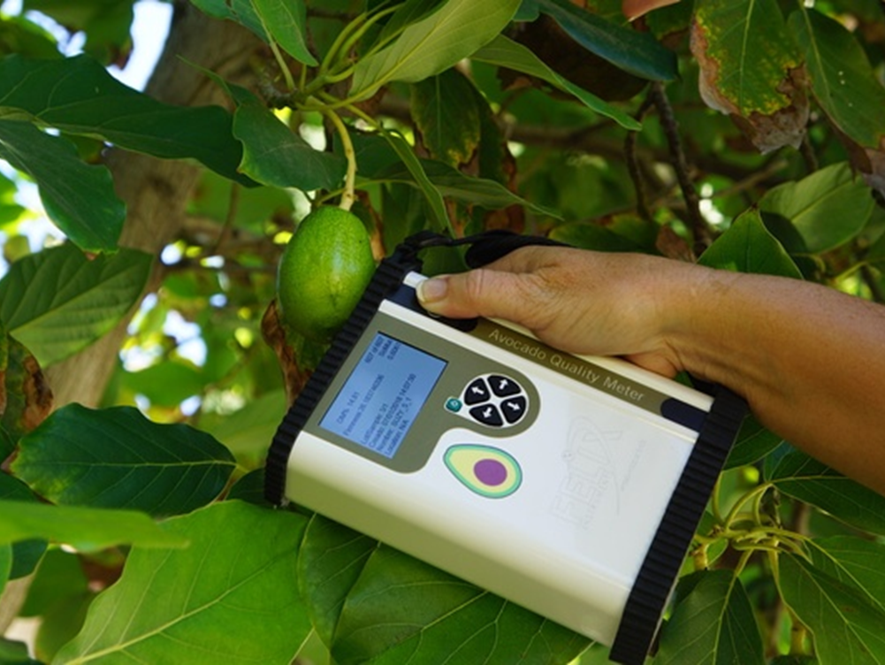
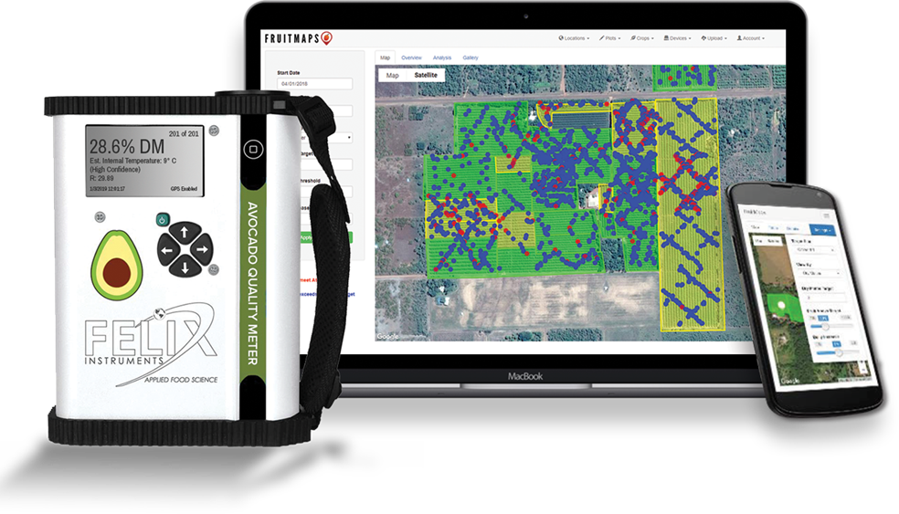
F-751 produce quality meters - Advantages
NO MODEL BUILDING REQUIRED
Ready-to-use “right out of the box”
Don’t need to have technical knowledge to operate the instrument
Lower price point than F-750
Non-destructive measurements
FruitMaps Integration

Slide 16
Ripening gases – Why they are important
C₂H₄: Many fruits ripen faster with ethylene present
Ethylene can quickly lead to decay and spoilage in sensitive commodities
CO₂: Produce respires carbon dioxide as it breaks down sugars for energy.
Determine metabolic activity by measuring CO₂
O₂: Produce needs oxygen to maintain cellular function
At very low O₂, anaerobic respiration occurs, damaging produce and causing spoilage
Ethylene can be added to stimulate ripening or degreening
Artificially elevating CO₂ through modified atmosphere packaging or in controlled atmosphere storage can slow respiration rates, making produce last longer.
Decreased O₂ can extend lifetimes of produce during long-term storage
Ethylene is made by fruits and sensed by fruits

Slide 17
Theory of Operation – Ethylene measurement
Real-time measurement device
Open or Closed System
Measure PPB or PPM
1000 PPB = 1 PPM
100 PPB = 0.1 PPM
image credit: doi:10.1093/aob/mcs259

Slide 18
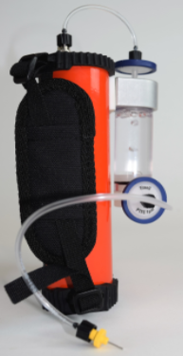
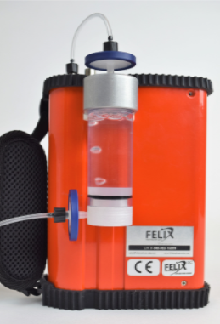
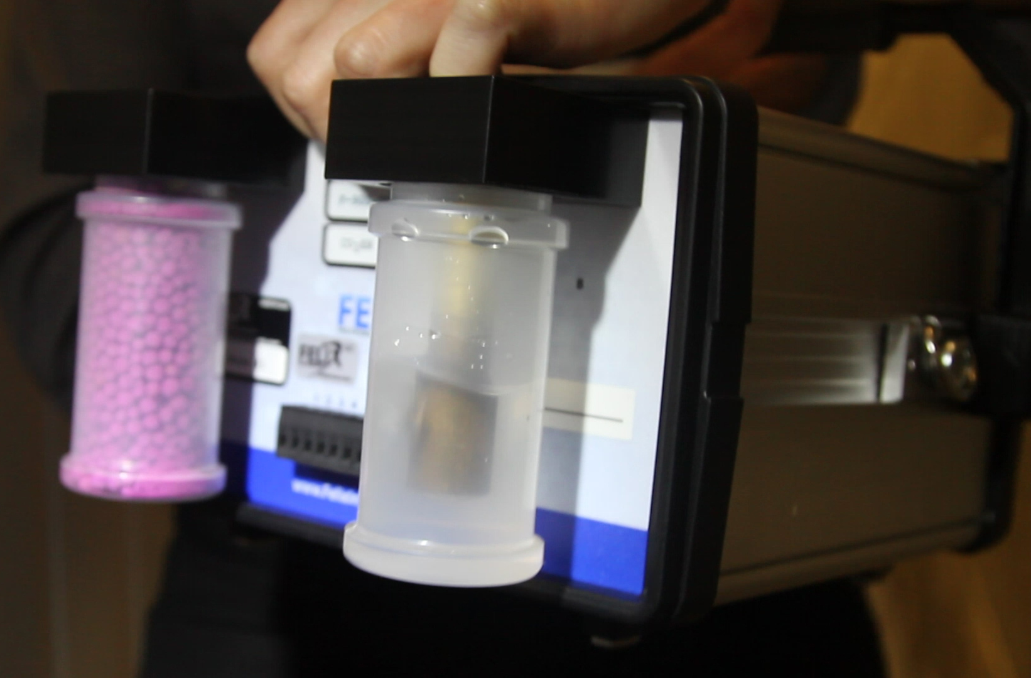
PolarCept Filter
PolarCeptTM
Patented water filter removes competing gases from the sample gas stream

Slide 19
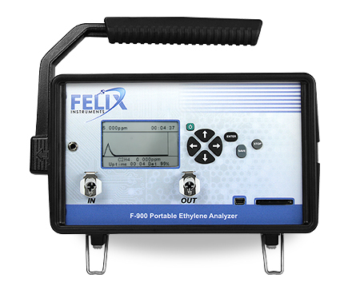
The F-900 Portable Ethylene Analyzer
Most sensitive ethylene gas analyzer
PPB - Down to 25 ppb (+/- 5%)
25 ppb = 0.025 ppm
PPM - Up to 200 ppm

Slide 20
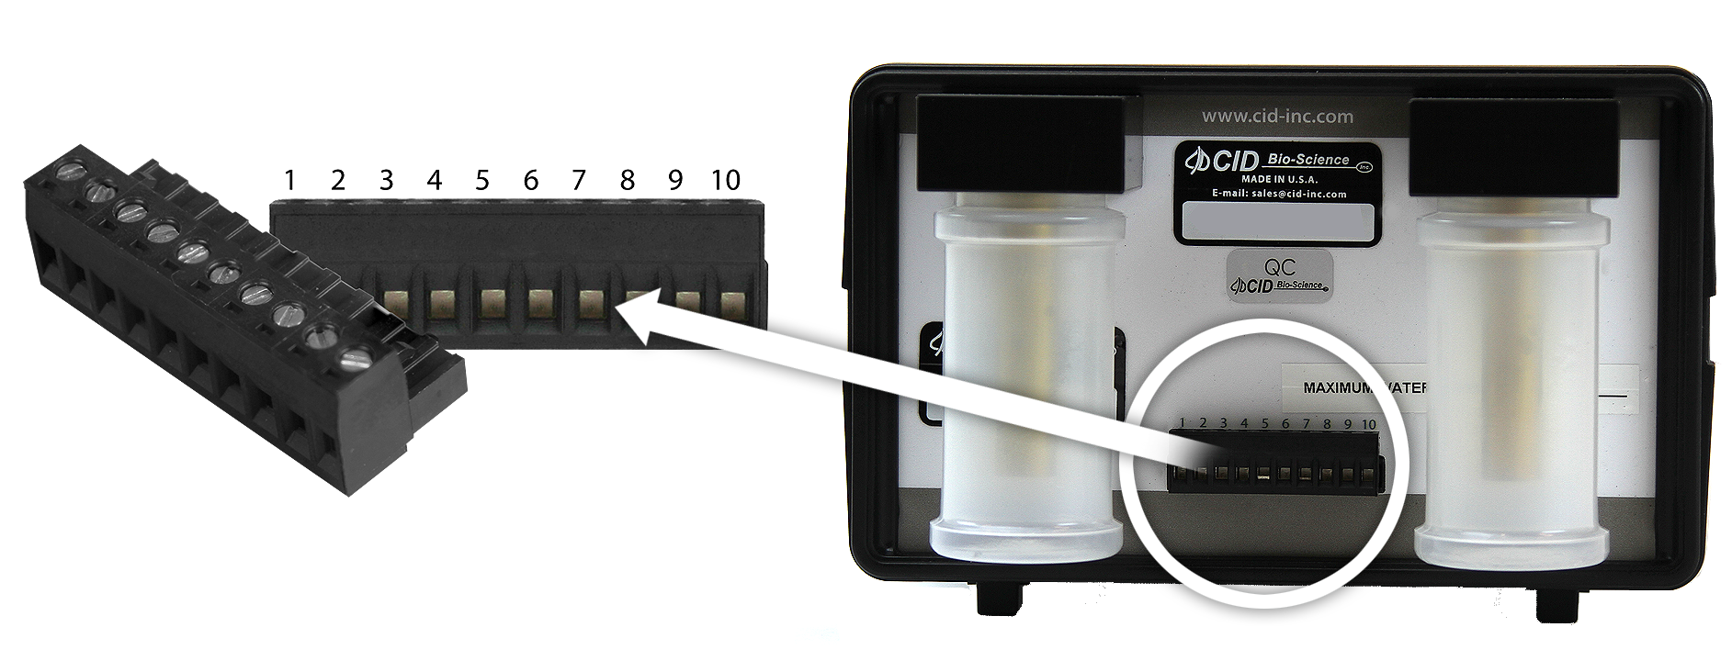
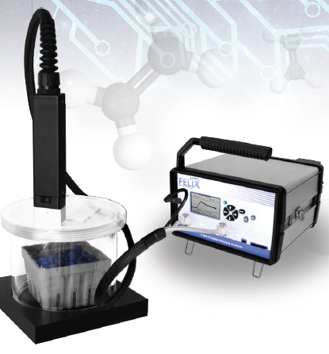
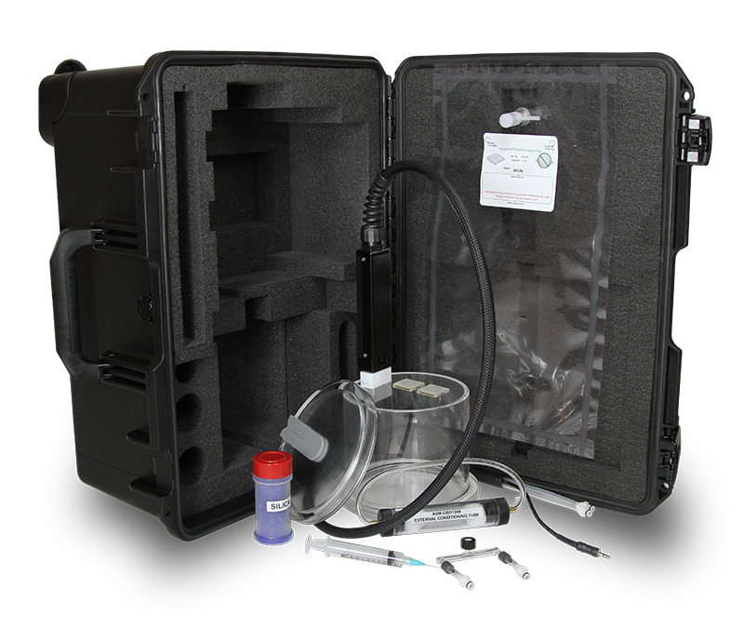
Applications
Continuous monitoring
Storage facility, greenhouse
Inspection device
CA rooms, containers
Fluxes from fruits and leaves
Pre-harvest, post-harvest
Headspace accumulation
GC Emulation Mode

Slide 21
The F-901R Accuripe & F-901S accustore – precision atmosphere control
F-901R AccuRipe:
Ripening Room Controller + Sensors
Monitor & Control CO₂, O₂, and C₂H₄ (Ethylene) levels
Eliminate guesswork in ripening room operations
F-901S AccuStore:
Storage Room Controller + Sensors
Monitor & Control CO₂, O₂, and C₂H₄ (Ethylene) levels
Dramatically minimize the risk of fruit spoilage and increase consistency of fruit quality in produce cold storage facilities

Slide 22
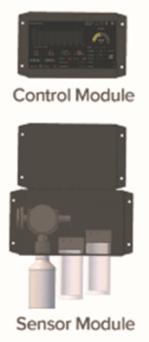
F-901R Accuripe – precision atmosphere control
Sensor Module:
CO₂: 0-100%
O₂: 0-100%
Ethylene: 0-10 ppm, 0-200 ppm, or 0-1000 ppm
Internal KMnO₄ Zero Gas Scrubber
Chassis (Control Module):
Modbus integration
Water resistant, low volume, low condensation design
High precision internal pump
Ideal for remote monitoring and control of produce ripening rooms

Slide 23
F-901S Accustore – precision atmosphere control
Sensor Module:
CO₂: 0-100%
O₂: 0-100%
Ethylene: 0-10,000 ppb
Internal KMnO₄ Zero Gas Scrubber
Chassis (Control Module):
Modbus integration
Water resistant, low volume, low condensation design
High precision internal pump
Ideal for remote monitoring and control of produce cold storage rooms

Slide 24
Handheld Gas analyzers

Slide 25
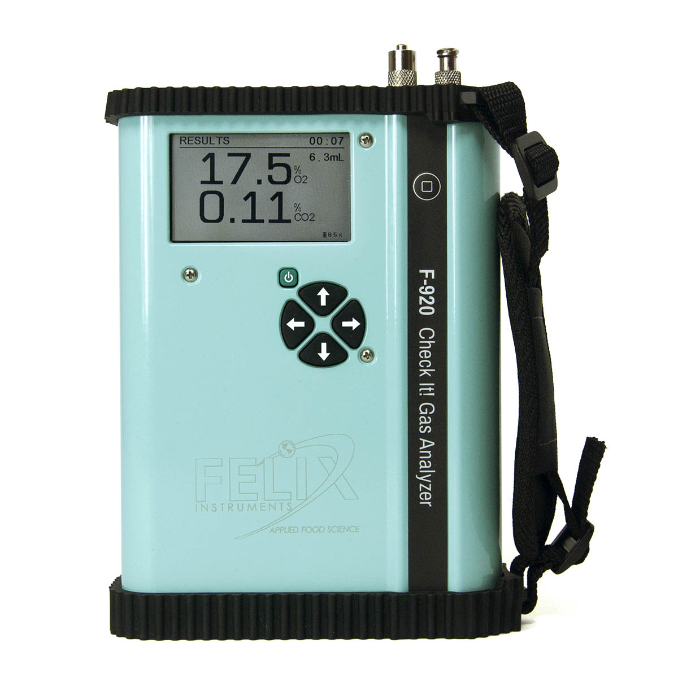
Gas Analyzers – F-920 Check it! Gas analyzer
Measures CO2 and O2
0-100% range for both sensors
Displays results in under 10 seconds
Ideal for MAP bags or inspection
Simple, fast operation for scenarios where ethylene isn’t a concern

Slide 26
F-940, F-950, and F-960
Measure CO2 and O2
0-100% range
Measure ethylene in different ranges
Data-logged internally
Internal potassium permanganate (ethylene removal) jar for clearing air between measurements

Slide 27
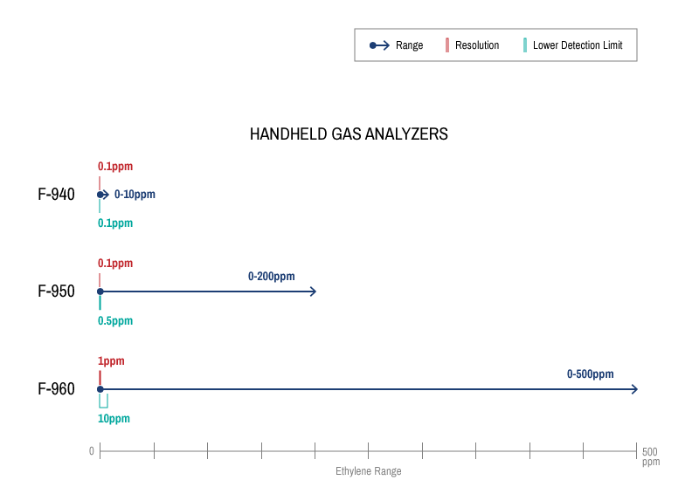
Blog Post and Infographic
Ethylene Range Chart
Blog post “How to choose the best gas analyzer for you”

Slide 28
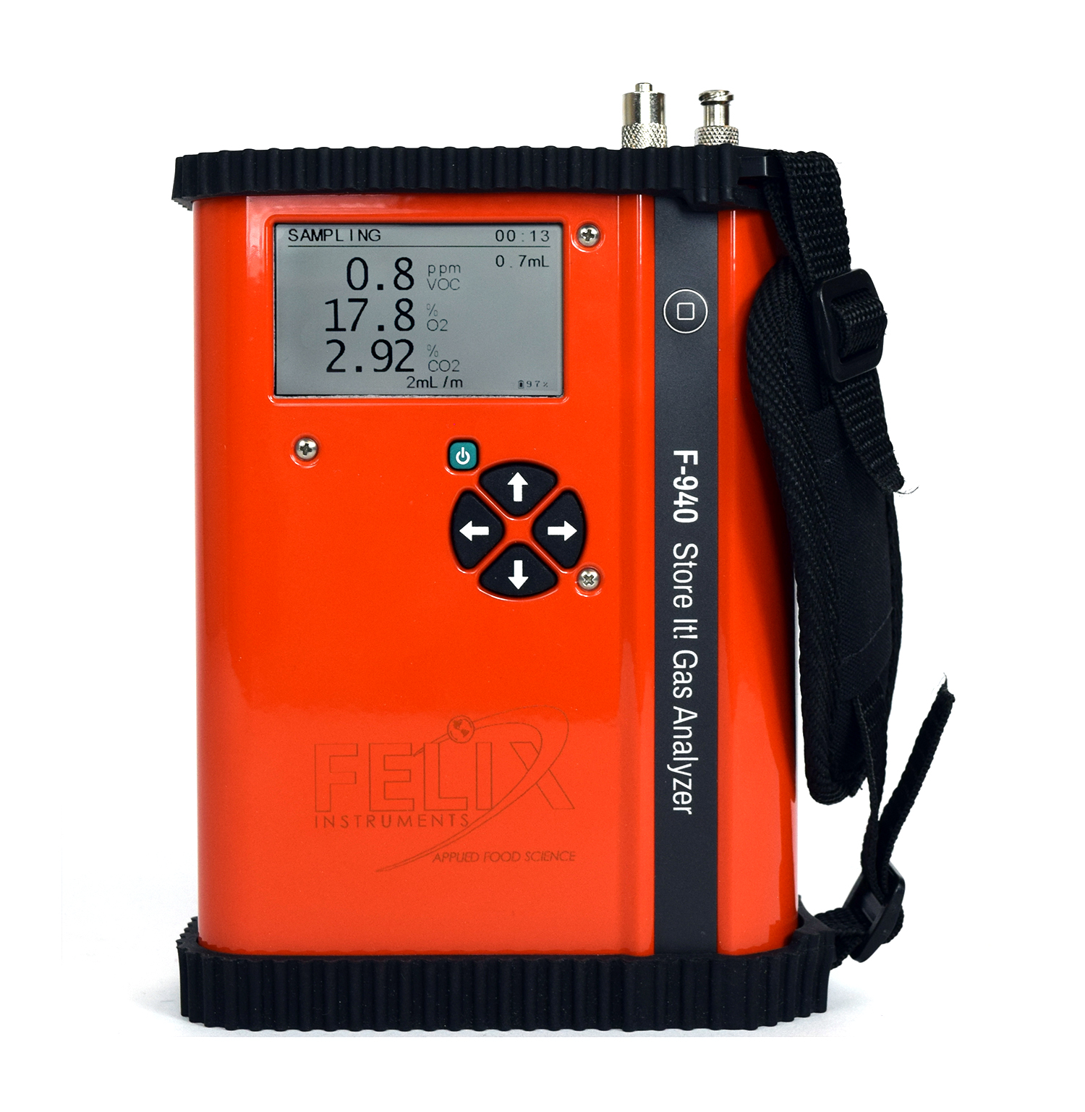
F-940 Store it! Gas analyzer
CO₂: 0-100%
O₂: 0-100%
Ethylene: 0-10 ppm
Lower detection limit: 0.1 ppm
Ideal for measurements of ethylene-sensitive commodities

Slide 29
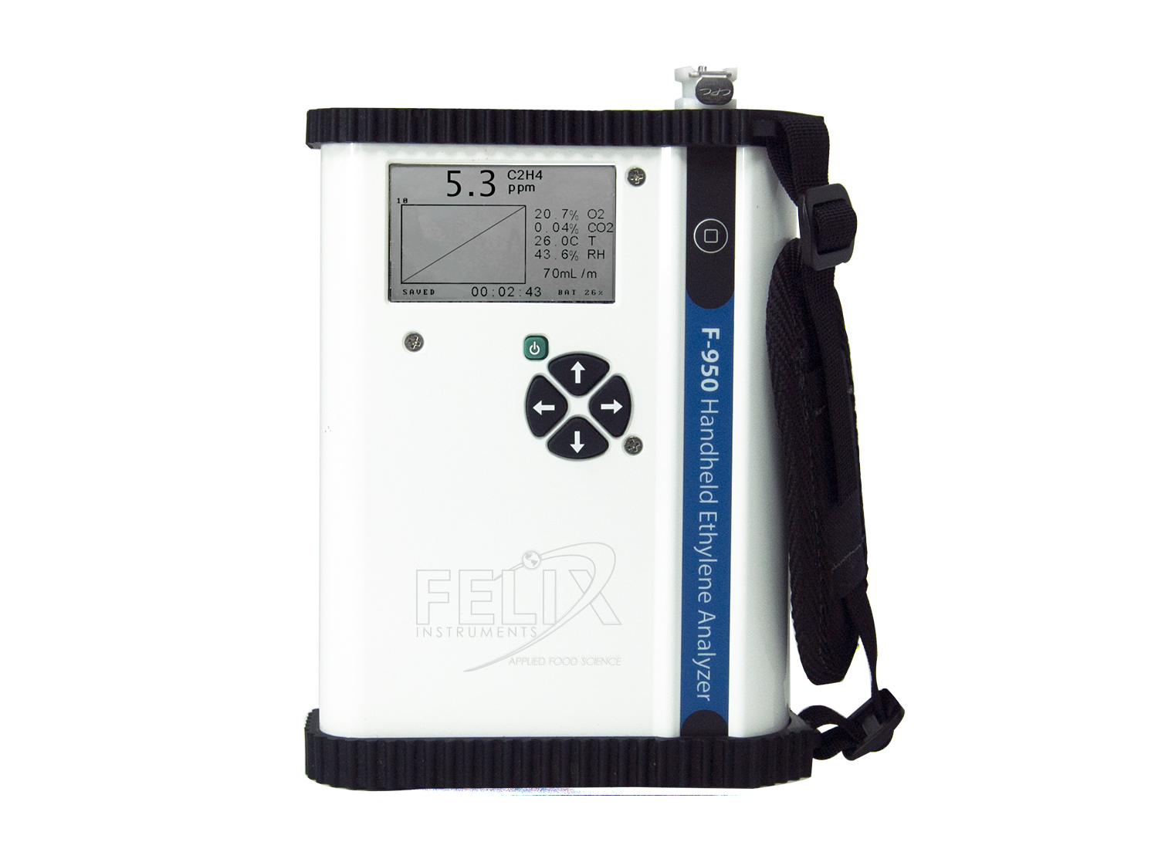
F-950 Three Gas analyzer
CO₂: 0-100%
O₂: 0-100%
Ethylene: 0-200 ppm
Lower detection limit: 0.5 ppm
Ideal for general purpose applications

Slide 30
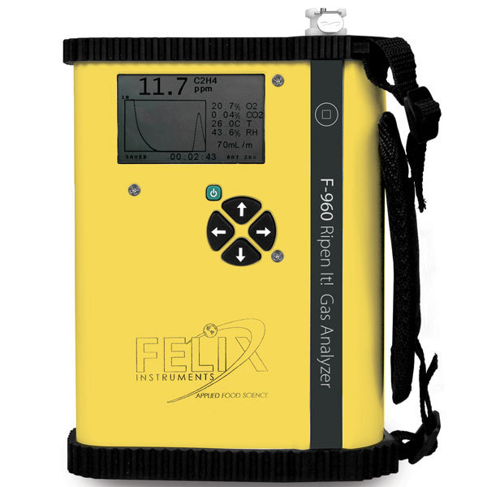
F-960 Ripen it! Gas analyzer
CO₂: 0-100%
O₂: 0-100%
Ethylene: 0-500 ppm
Lower detection limit: 10 ppm
Ideal for forced ripening applications

Slide 31
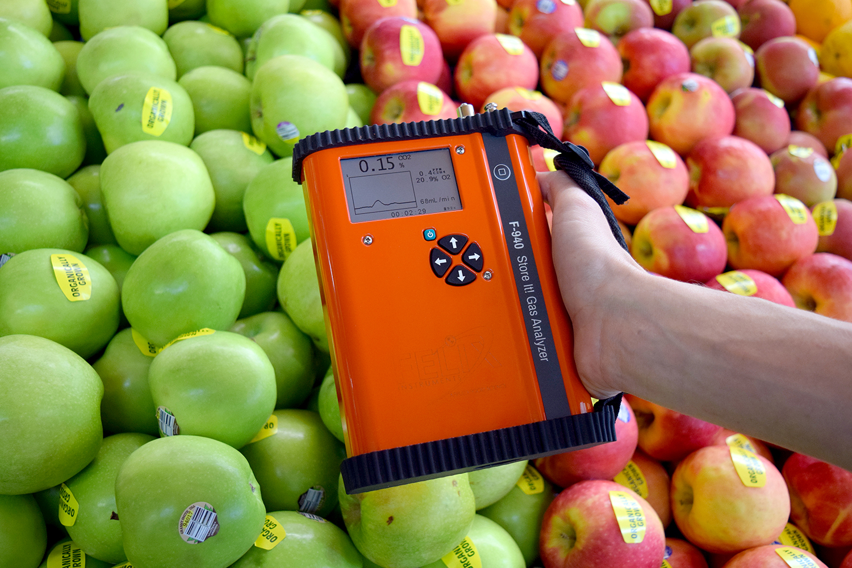
Applications – Continuous mode
Continuous Mode
Live-updating graphs of gas concentrations
Data saved every one second
For measurements in a changing environment
Use for tracking down areas of high gas accumulation

Slide 32
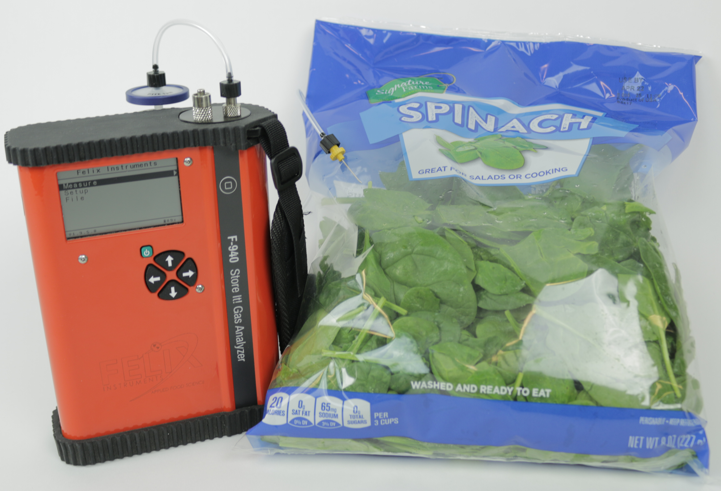
Applications – Trigger mode
Trigger Mode
Continuous flow-through until stable value is reached – small sample volumes possible
One final value is reported and recorded
Inspection tool
Ideal for gas levels checks of static locations
Measurements from Modified Atmosphere Packaged
Measurements of headspace accumulation in jars

Slide 33
Calibration Schedules – available online
Instrument | Sensor | Zero | Span | Full
F-950 | PPM Ethylene | Weekly | Bi-annually | Annually
F-950 | CO2 PERCENT | Bi-annually | Bi-annually | Annually
F-950 | O2 | Bi-annually | Bi-annually | Annually

Slide 34
Competitor information – Available on Distributor resource site
 | F-950 | EMS MACView | Mocon | OxyBaby
Ethylene range | 0.5-200 ppm | 0-5 ppm | Not available | Not available
CO2 | 0-100% | Not available | 0-30% | 0-100%
O2 | 0-100% | Not available | 0-100% | 0-100%
Calibration | Annually | Weekly | Annually | Annually

Slide 35
Recommended sales activities
Strong Web presence
Complete resources available at sales.felixinstruments.com
Phone calls
In-person visits
Evaluations
Conferences
Tradeshows

Slide 36
Conferences to present Felix Instruments
Tradeshows
Produce Marketing Associations
Regional produce conferences
Academic Conferences
Horticultural conferences
Postharvest conferences
Commodity-specific events

Slide 37
Key Customers
Companies focused on Brand and Quality
Quality Assurance Managers
Fieldmen
Crop consultants
Warehouse Managers
Research and Development Staff
Importers
Exporters
Fruit Surveyors
Academic fruit and vegetable Researchers

Slide 38
Sales Opportunities
Customer visits
Evaluations are key!
Commodity-specific brands
Regional knowledge of the marketplace
Model Building Service for revenue

Slide 39
Felix instruments direct sales pipeline
Send Pricing Quickly
Phone call with Application Scientist
Follow up!

Slide 40
Resources
Sales Team Website
sales.felixinstruments.com
Brochures
Photos
Graphics
Logos
Videos
Certificates
Press Releases
Manuals
Specifications Documents
Training
Newsletters

Slide 41
Questions
Suzy Truitt | International Distributor Manager | Sales struitt@felixinstruments.com
Eric Munoz-Garcia | Application Scientist | Support
support@felixinstruments.com

