Slide 1
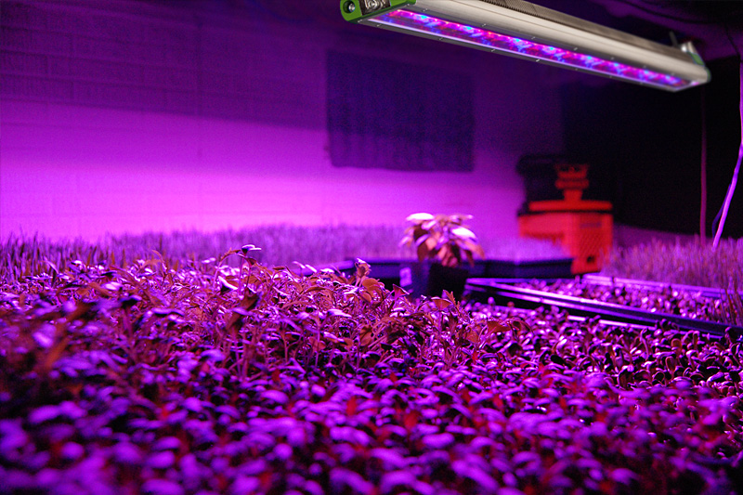
CI-800 LED Experimentation
System
Conducted by: Brienne Meyer
bmeyer@cid-inc.com

Slide 2
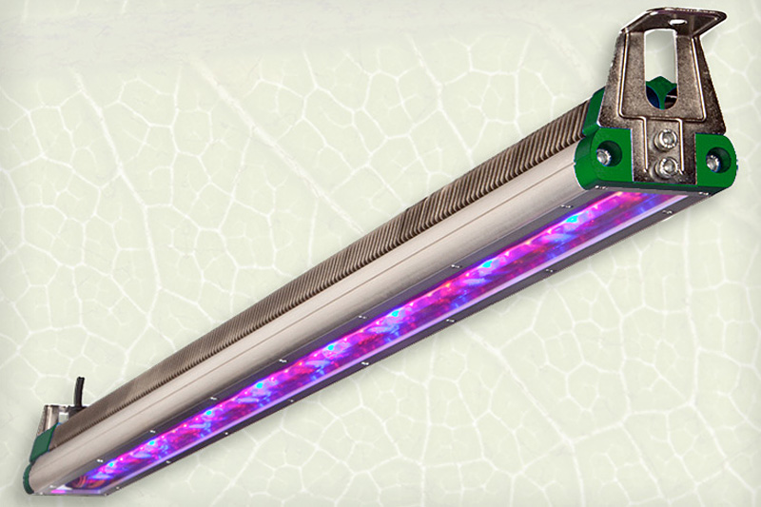
Agenda/Outline
Introduction
Theory of Operation
LightSnap!
CI-800 Hardware
CI-800 Network Setup
LED vs. Fluorescents
CI-800 Applications

Slide 3
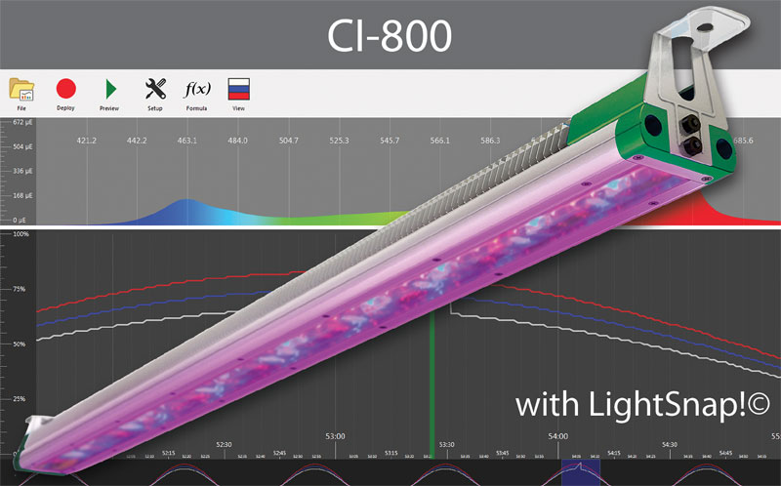
What is the CI-800?
LED plant growth lighting

Slide 4
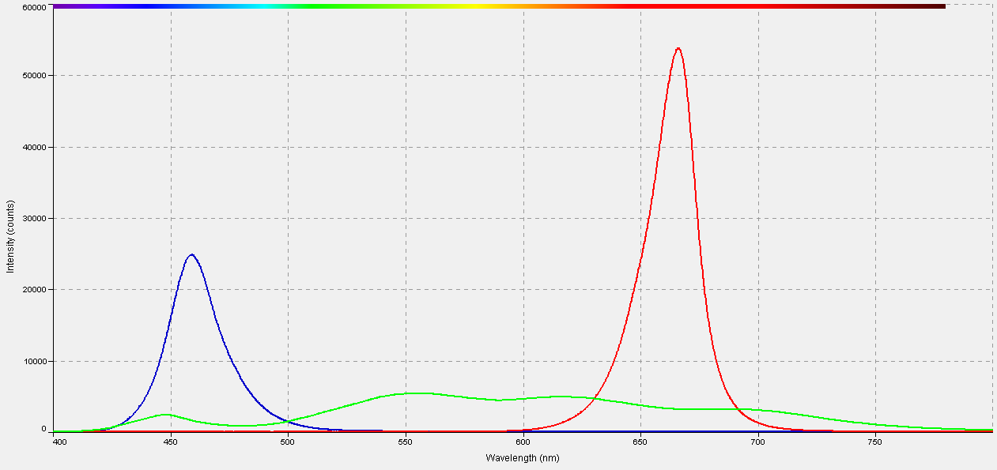
CI-800 Theory of Operation
Blue & Red LEDs
Sufficient for plant growth & development
White LEDs
Provide supplemental light
BLUE
WHITE
RED

Slide 5
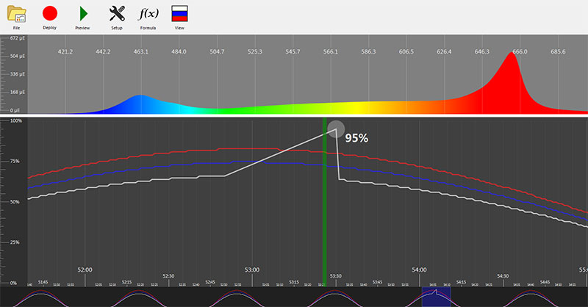
LightSnap! Software
Control LED colors independently
Schedule lighting
Upload light recipes via WiFi

Slide 6
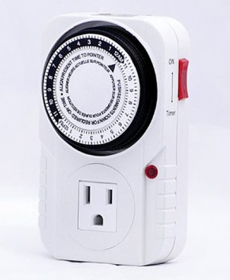
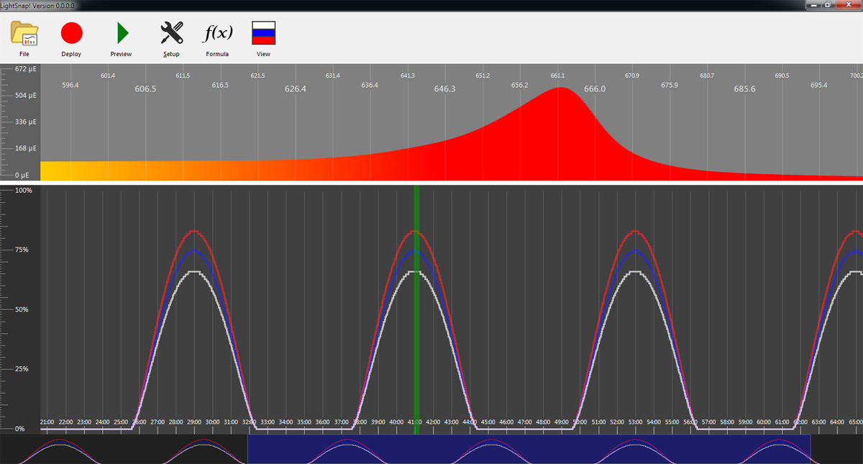
LightSnap! Continued
Precise control
Timing of lights on/off
Lighting output
Independently control LEDs
A big improvement over analog dials and wall timers!

Slide 7
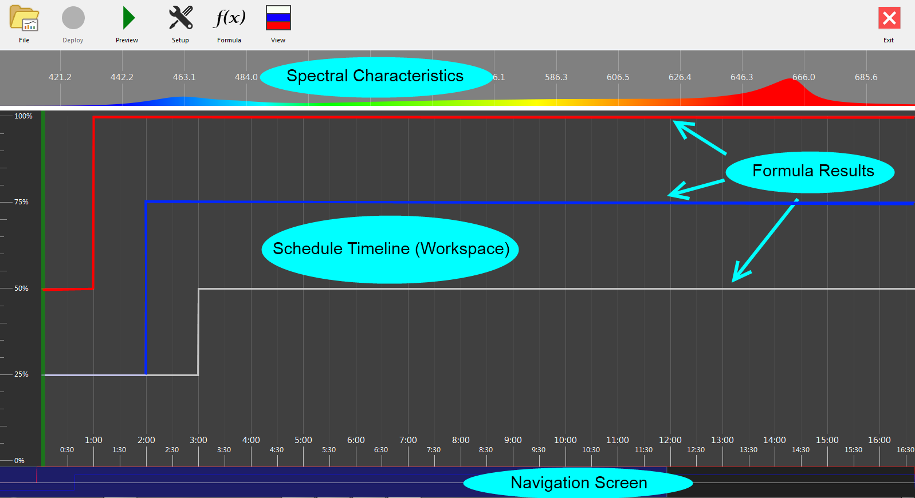
LightSnap! Workspace

Slide 8
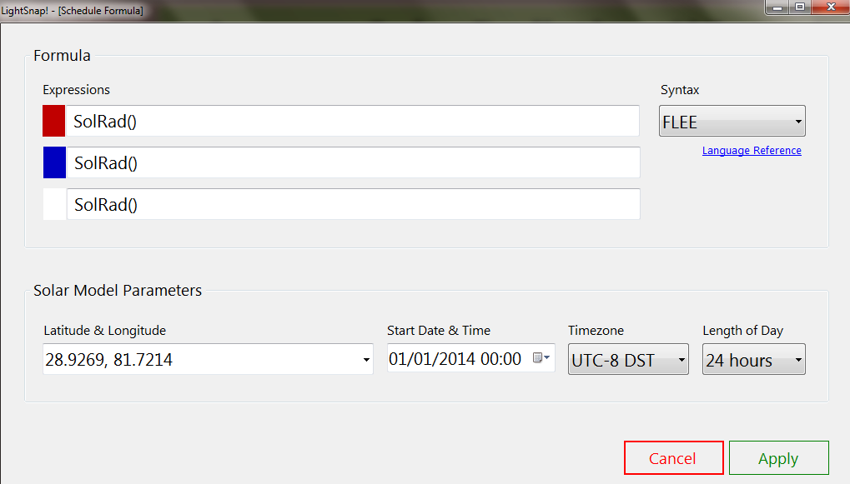
Average Solar Radiation: Winter in central Florida’s Citrus Belt
Longitude & latitude: 28.9269° N, 81.7214° W
January 1st Start Date
Drop-down list of countries
  pre-entered longitude and latitude

Slide 9
Light Recipes
Plant | Day length | PAR¹ | Red | Blue | Reference
Arabidopsis | 14h | 200µE | 80% | 20% | Acta Horticulturae 956
Cucumber | 16h | 100µE | 93% | 7% | 10.1093/jxb/erq132
Rice | 12h | 240µE | 80% | 20% | 10.1093/pcp/pch203
Tomato | 12h | 320µE | 50% | 50% | 10.5897/AJB11.1191
1 µE = µmol ∙ m⁻² ∙ sec⁻¹
Note: These recipes are intended as guidelines; the research was made with LED fixtures from various other manufacturers.

Slide 10
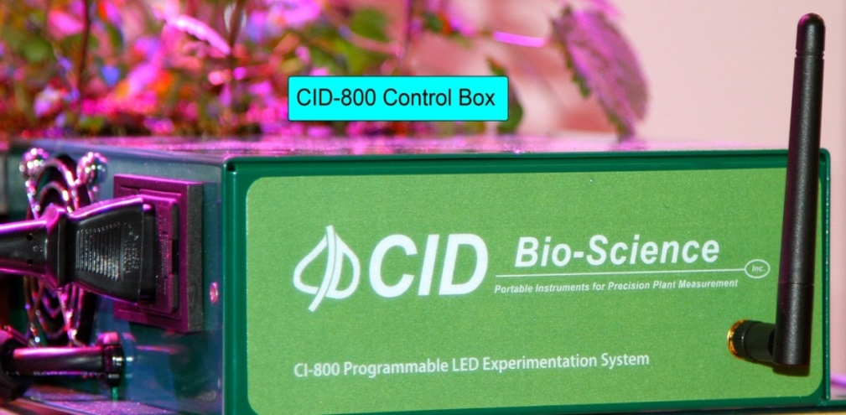
CI-800 Hardware
CI-800 package consists of 6 components:
LED light bar
Control box
CI-800 User Manual
Installation CD
2 light bar mounting brackets
4 screws
A/C power cord for the control box

Slide 11
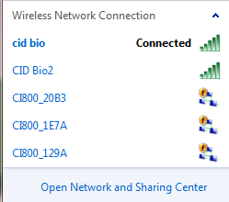
CI-800 Network Setup
Turn on control box
Navigate to Connect to a Network
Select CI-800_XXX
Wait 2 minutes for computer and CI-800 to connect

Slide 12
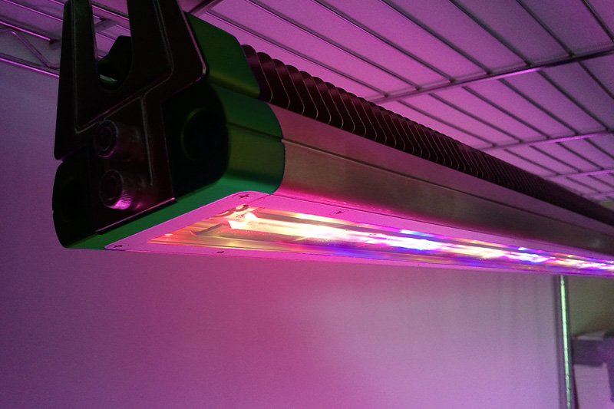
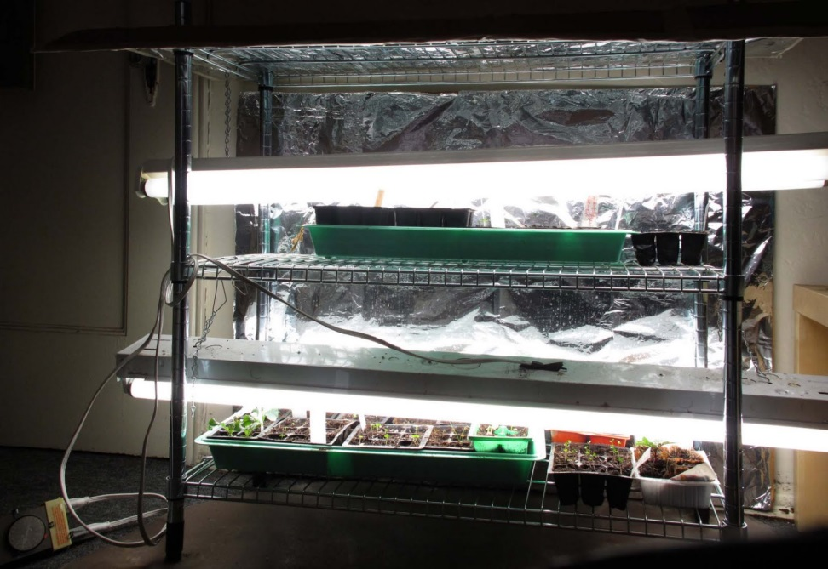
CI-800 LED vs. Fluorescent Light
CI-800 LED Pro’s | Fluorescent Con’s
50% less electricity | Sloppy
Cool operation | Wasteful
No hazardous waste | Inefficient
High LED entry cost is paid back over time

Slide 13
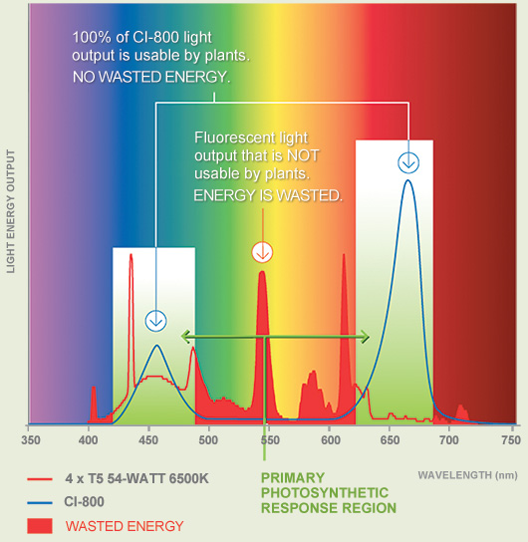
CI-800 vs. Fluorescent Continued

Slide 14
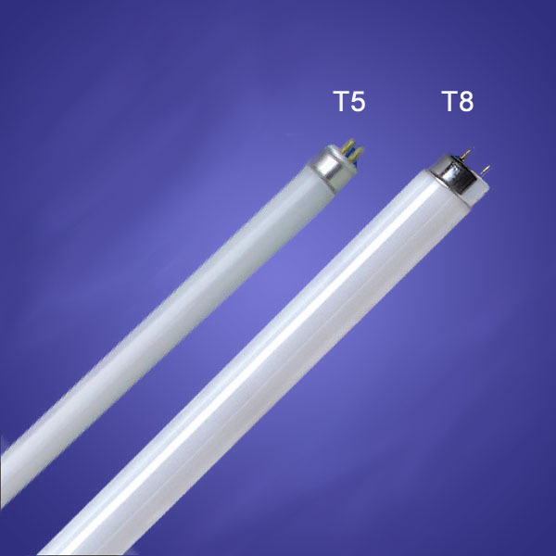
CI-800 vs. Fluorescent Light III
 | CI-800 | T8 Fluorescent | T5 Fluorescent
Operating Temp | -20-60^{O}C | 25^{O}C | 35^{O}C
Lifespan (hours) | 50,000 | 20,000 | 16,000
Operating Frequency (Hz) | 50-60 | 40-50 | 50-60
Source: tropicalfishsite.com

Slide 15
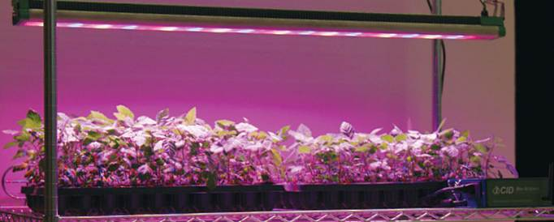
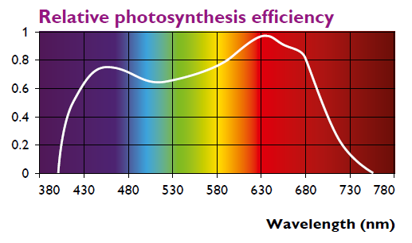
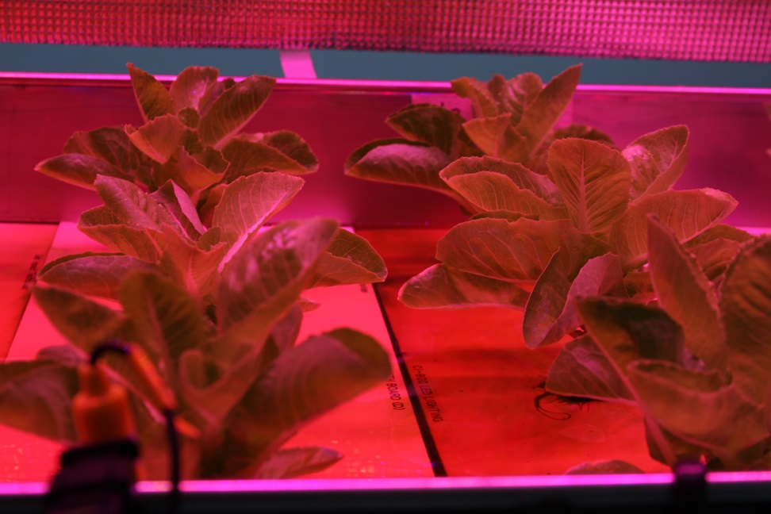
CI-800 Applications
Shelf-mounted for easy installation
Replaces fluorescents
Heirloom Tomatoes under CI-800
James Chang, Geb Impact Technology Co.
University Collaboration, Hong Kong

Slide 16
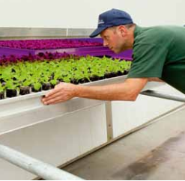
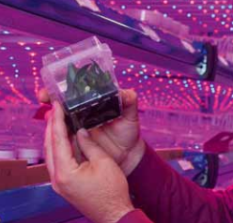
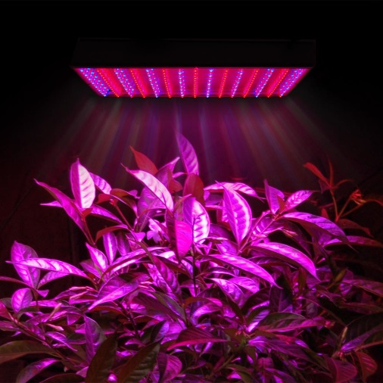
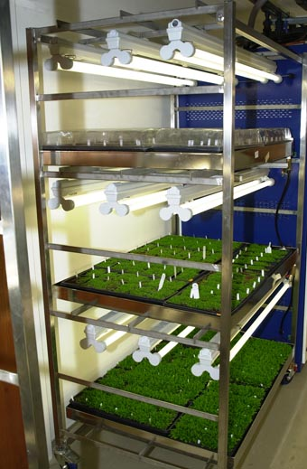
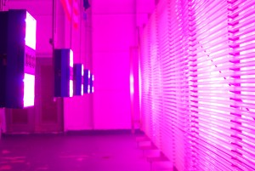
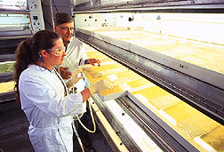
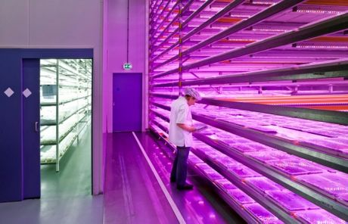
Source: Philips lighting
Source: Philips lighting
Source: thelashop.com
Arabidopsis and other plant growth rooms
Tissue culture & plant propagation
Algae Cultivation and Insect Rearing
Source: Scott Bauer Courtesy USDA
Source: freshplaza.com

Slide 17
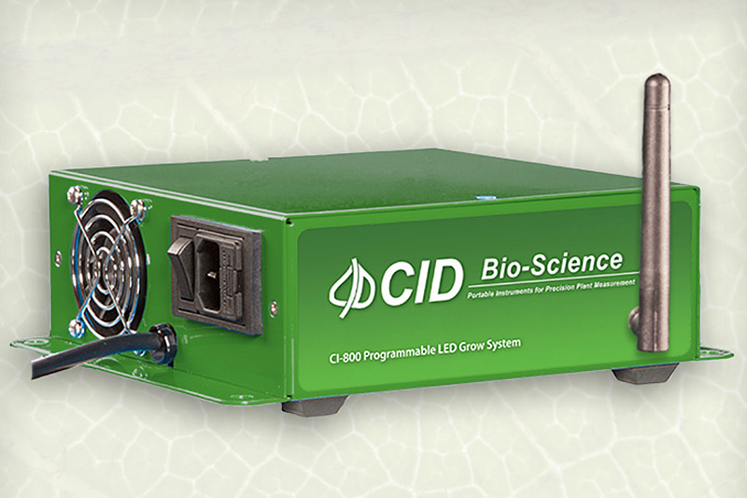
CI-800 Troubleshooting
How do I reset the CI-800 control box?
  Disconnect your PC from the CI-800 if you are connected via Wi-Fi.
  Turn the device on.
  Turn the device off when White LED turns off (indicating boot completed.)
  Repeat this until the Red LED turns on and stays on.
  The Red LEDs will stay on while the device is resetting.
  When the Red light turns off, factory reset is complete.
  If the factory reset was successful:
    Blue, Red and White LEDs briefly light up
    sequentially and repeat.
  If the factory reset was not successful:
    All the LEDs will turn off.
    If this happens, turn the control box off and
    back on to repeat the factory reset process.

Slide 18
LightSnap Software
Open software and create a light schedule

Slide 19
Connecting Multiple Lights to a Network
Can deploy the same light schedule to all control boxes (one after another)
Software still in “Beta”
http://cid-inc.com/Software/Beta/CI-800/Internal/

Slide 20
Connecting Multiple Lights to a Network
When the CI-800 is initially unboxed and turned on it will create it’s own WiFi hotspot / access point called CI800_XXXX (where XXXX are random).
The user needs to connect to that CI800_XXXX network from their PC. (You no longer need to manually enter the IP address.)
Next from LightSnap the user now needs to go to Setup \ Connect Light Bars… to connect to the light bar.
Once connected they can go to Setup \ Advanced \ Light Bars \ Network Settings… to configure the light bar to connect to their own network.
Note: The user will need to repeat steps 2-4 for each light bar until they have all been switched to their network. And after they tell the light bar to connect to their own network they need to remember to connect their PC to the same network. Then when they go to Setup \ Connect Light Bars… and scan for light bars they will see all the CI-800’s connected to their network and will be able to control them as if they were a single light bar.
If a light bar does not appear in the network, it could already be connected to a different network. Perform a factory reset of the control box.

